Slide 1


Slide 2

Educational support for this course was
generously provided by:

Slide 3
Outline
Patient Assessment
  History and Physical
  Laboratory Assessment and Imaging (where relevant)
  Functional Status Assessment
Review of Delegation
  How to provide delegation
  How to accept delegation

Slide 4

Adequate Patient Assessment

Slide 5
My experience
Many providers fail to ensure adequate history taking and assessment
Many providers fail to reassess patients at regular intervals for tolerance and efficacy of therapy
Many providers fail to recognize potential complications of therapy and take appropriate measures

Slide 6
Initial Patient Assessment
All of the following should be a part of an IVIT assessment
  History of complaint and full medical history including:
    Allergies, current meds (may need authorization), family history, etc.
  Symptom assessment
  Pathology report/surgical pathology report (confirm diagnosis where appropriate)
  Imaging (to ensure pre-surgical/post surgical staging)/anatomical risks
  Laboratory work up
  Psychosocial and cultural review
  Power of attorney where appropriate

Slide 7
Functional or Symptom Assessment
QOL/wellbeing improvements are a common goal and outcome of treatment
They can be difficult to assess objectively
Validated symptom assessment tools should be used at a new patient visit and regularly during follow up

Slide 8
Common Cancer Functional Assessments
Examples of assessments include:
  Karnofsky Performance Index (KPI)
  Eastern Cooperative Oncology Group Performance Status (ECOG)
  Symptom Severity Scales
  Edmonton Symptom Assessment Survey (ESAS)
  Patient Reported Functional Status (PRFS)
  European Organisation for Research and Treatment of Cancer (EORTC QOL)

Slide 9
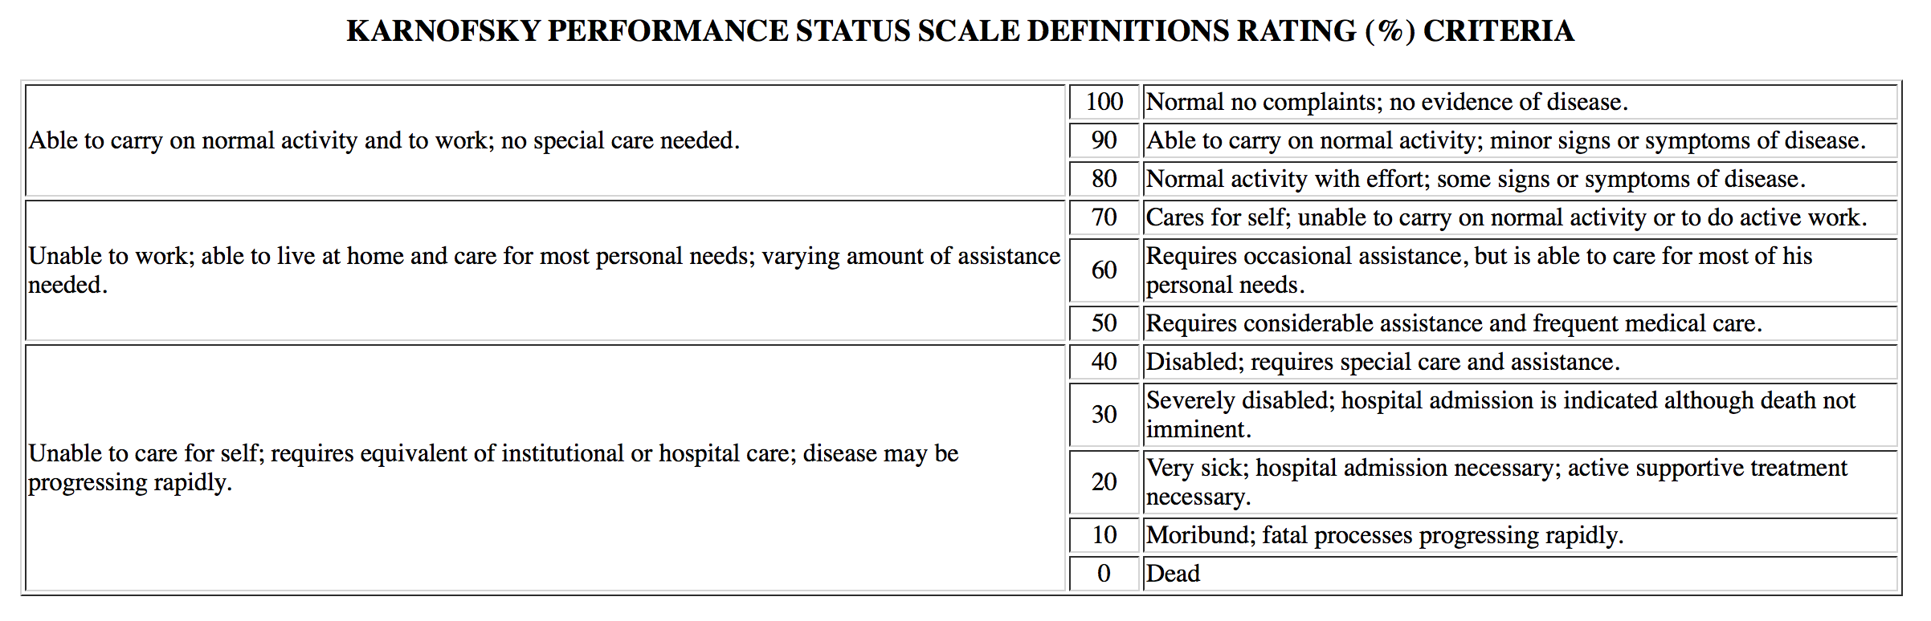
KPI

Slide 10
KPI cont’d
The Karnofsky Performance Scale Index allows patients to be classified as to their functional impairment.
This can be used to compare effectiveness of different therapies and to assess the prognosis in individual patients. The lower the Karnofsky score, the worse the survival for most serious illnesses.
It is physician conducted after a careful and complete assessment

Slide 11
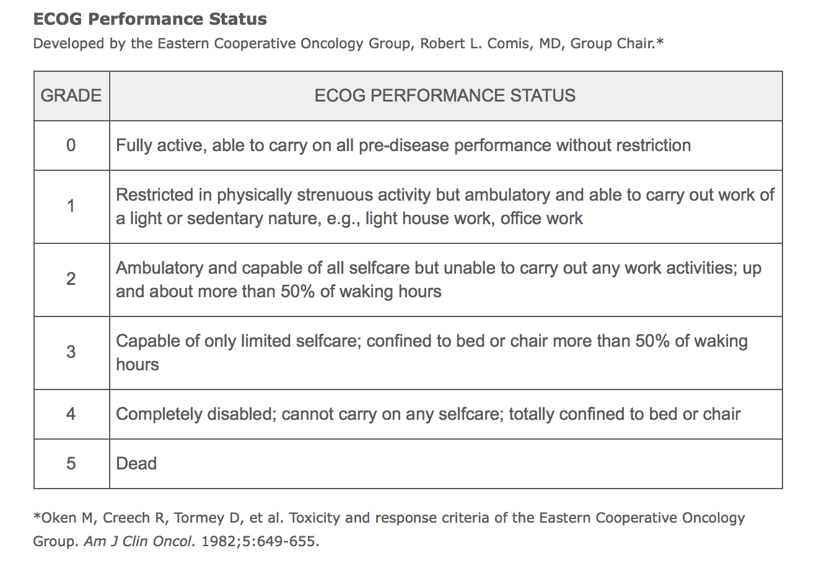
ECOG

Slide 12
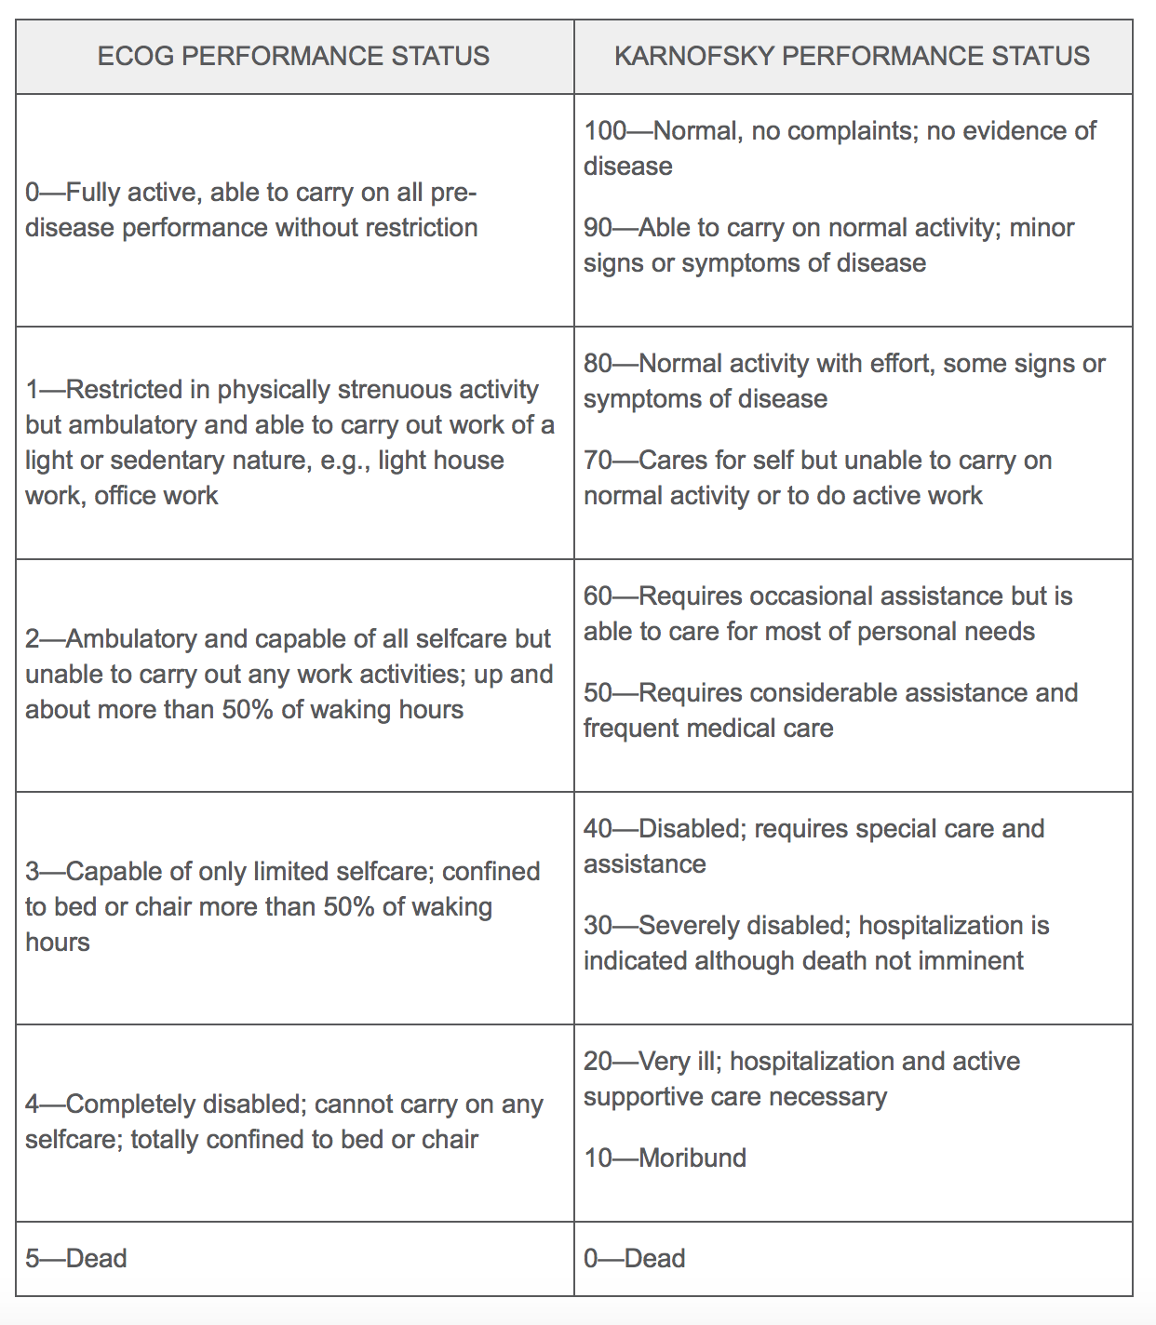
ECOG vs. KPI

Slide 13
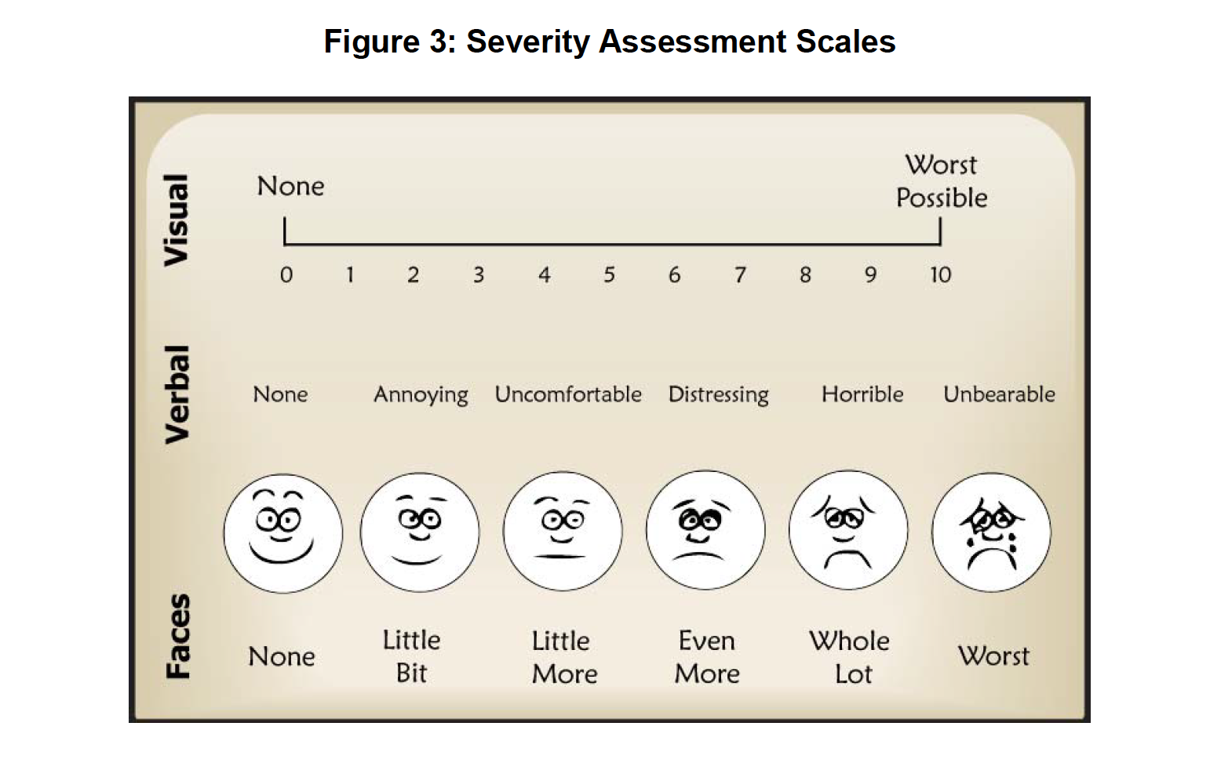
Visual Severity Assessment Scale

Slide 14
ESAS
A valid and reliable assessment tool to screen for the intensity of nine common symptoms experienced by cancer patients:
  pain
  tiredness
  nausea
  depression
  anxiety
  drowsiness,
  appetite
  well-being
  shortness of breath.

Slide 15
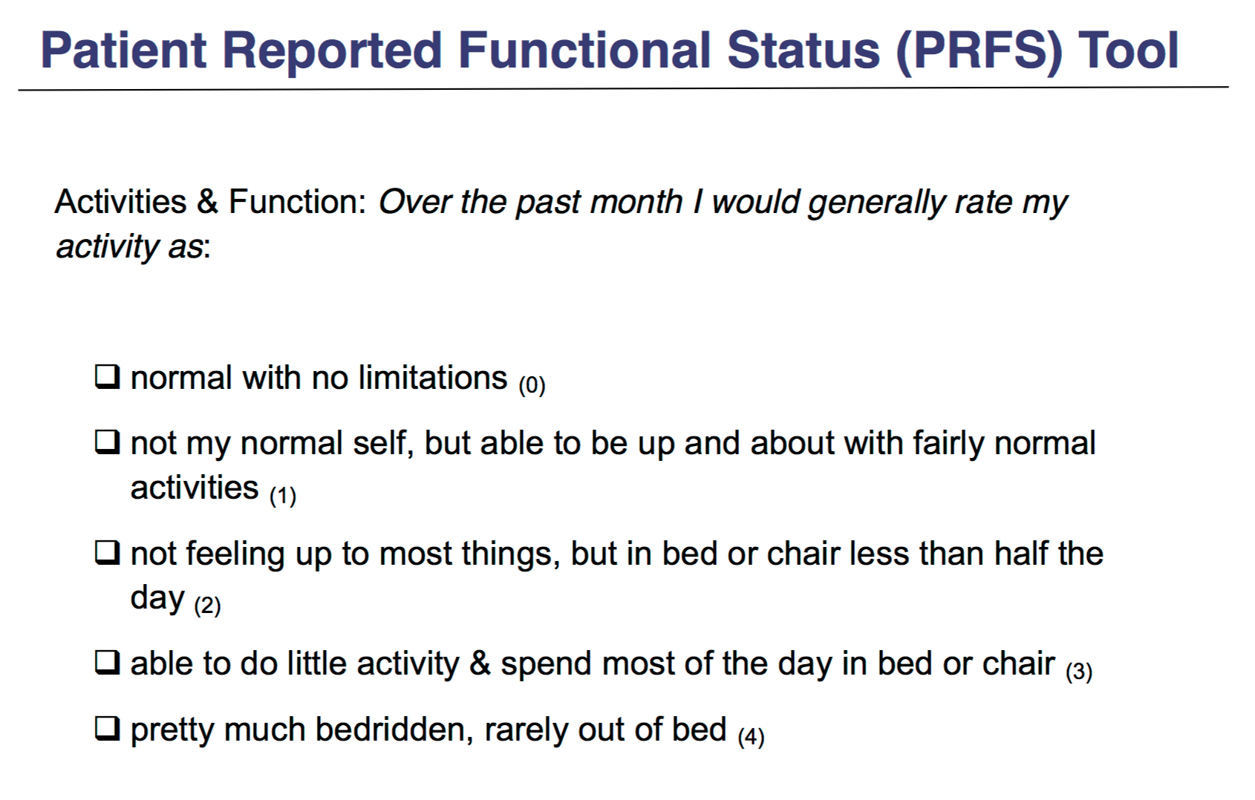
PRFS

Slide 16
PRFS
This is used in palliative care settings in addition to other symptom assessment tools
It can help predict survival
Patients will show gradual decline over the last 6 months of life with a more rapid decline coming 3-4 weeks before death
It can also help in understanding the need for support services and referral
It should be completed at all follow-up visits

Slide 17
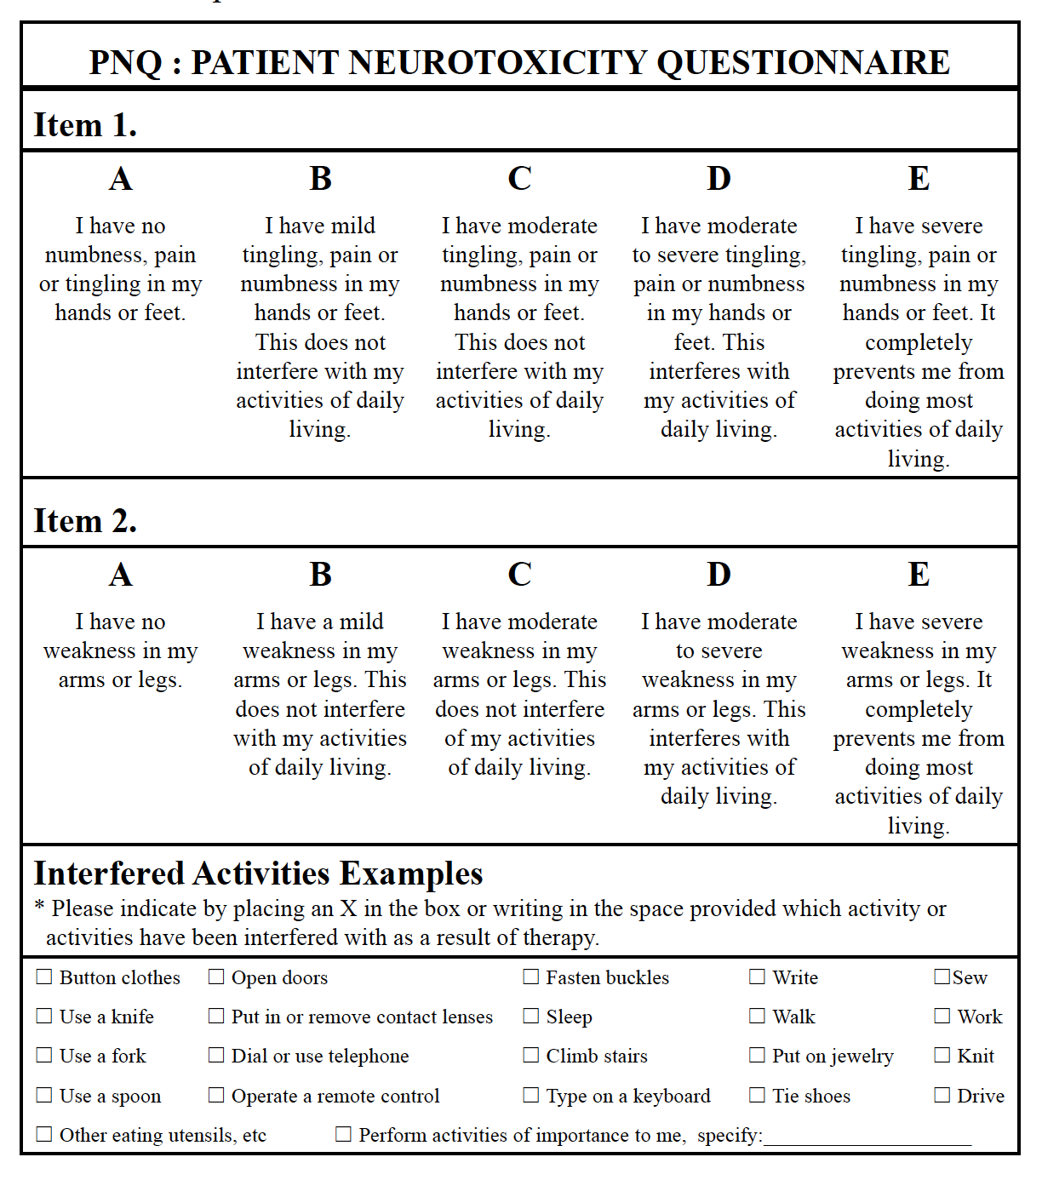
Neuropathy
(PNQ)

Slide 18
Chronic Fatigue/Fibromyalgia Assessments
Fatigue Scale
Fibromyalgia Impact Questionnaire

Slide 19
Depression and Anxiety Assessments
HAM –D
HAM -A

Slide 20
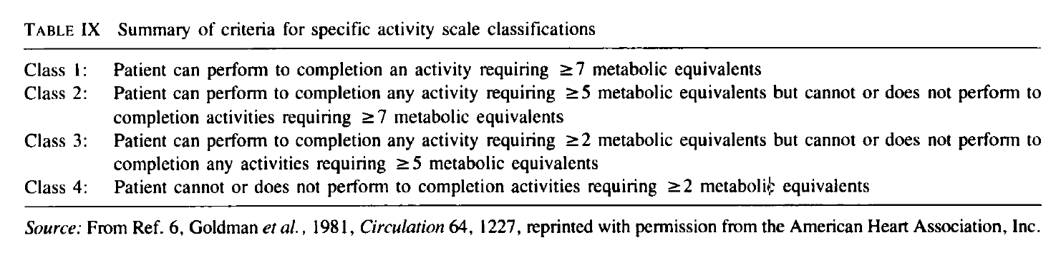
Cardiovascular Assessments
METs activity

Slide 21
Imaging & Laboratory Assessment

Slide 22
Key Laboratory Assessments
Hematology
  CBC with differential
Renal
  Creatinine, Uric Acid/Urea, Na, K, Ca, Mg, Cl
Hepatic
  AST/ALT, ALP, Albumin, Bil (Total/Direct), Albumin
Disease/Therapeutic Testing

Slide 23
Imaging
Essential for any patient with abdominal metastasis to ensure organs of elimination are not affected
  Renal (ureter obstruction) – care in all IV fluid administration
  Hepatic/Biliary – care in Curcumin, DCA, GZA, Silybinin
Essential for patients with potential malignant effusion(pleural or pericardial)/ascites – care with high volume infusions
Ensure safety of IV viscum

Slide 24
Fluid Imbalances
Many patients have fluid imbalances and may show both dehydration in the vascular compartment and some areas and fluid excess in certain extra vascular compartments
IV fluids can complicate these situations
In patients with pleural effusion, pericardial effusion, lower limb edema, lymphedema, etc. use a cautious approach to fluid administration
I recommend CHF guidelines of no more than 250 mL total fluid volume per treatment and no more than speed of 2 mL/minute

Slide 25
Follow up Care
Patients require ongoing evaluation and follow up
This can be challenging in situations where the provider is administering therapy to the patient
Ensure follow ups and laboratory assessments are completed regularly
Symptom questionnaires or performance status assessments should be done at each visit
Use symptom severity assessment tools to quantify specific symptoms

Slide 26
Follow up Frequency
Appropriate testing based on High Risk/Low Risk patients
We reassess for safety and efficacy
If goals of treatment involve improvement in functional status
  First reassessment 2-4-6 weeks (generally the patients with the lowest functional status improve more quickly with aggressive care)
Safety Review
  High risk (e.g. fluid/electrolyte imbalances, anatomical/physiological risks)
    Every 1-2 weeks

Slide 27

Delegation

Slide 28
Delegation
Introduction
The Naturopathy Act 2007 provides NDs the ability to delegate controlled acts
This is a new ability and responsibility for NDs to have

Slide 29
Delegation
Definitions in CONO standards
Controlled Act: means a controlled act set out in subsection 27(2) of the Regulated Health Professions Act, 1991.
Delegatee: a person to whom delegation is made.
Delegation: For the purposes of this Standard of Practice, delegation is a process whereby a member authorized to perform a controlled act procedure under the Naturopathy Act, 2007 confers that authority to someone - regulated or unregulated - who is not so authorized and not a member of this profession (e.g. a ND registered with the College of Naturopaths of Ontario cannot delegate an authorized act to another ND registered with the College of Naturopaths of Ontario). A delegation is not a referral.
Delegating or accepting delegation of controlled acts is subject to any applicable college guidelines, standards and regulations.
Delegator: a person making the delegation.
Exempted Act: means a whole or part of a controlled act that is not authorized to the profession but may be performed by Naturopathic Doctors via an exemption in the Regulated Health Professions Act, 1991.
Referral: A process whereby a member makes a formal request for care to another regulated health care practitioner on behalf of the patient and is supported by documentation containing appropriate background information on the patient and outlining the reason for the referral.

Slide 30
Delegation Definitions: Federation of Health Regulatory Colleges of Ontario
Direct Orders
Are for a specific patient upon assessment by the physician/ authorizer that the procedure is warranted.
Are also known by other names such as prescriptions, requisitions, pre-printed orders/order sets, requests for consultation, doctor's notes and may be given as a referral for treatment.
Are usually written but provision has been made for telephone and electronically transmitted orders (regulations under the Public Hospitals Act (PHA)) and verbal prescriptions (provisions under the Drug and Pharmacies Regulation Act (DPRA)). Due to the potential for error and accountability issues, verbal orders are not recommended in multi-practitioner settings when an authorizer is present and able to write the order.

Slide 31
Delegation Definitions: Federation of Health Regulatory Colleges of Ontario
Medical Directives
Are given in advance by physicians/ordering authorizers to enable an implementer to decide to perform the ordered procedure(s) under specific conditions without a direct assessment by the physician or authorizer at the time.
May authorize co-implementers, that is: one implementer may be responsible to determine when to implement the ordered procedure and another may perform it.
Implementers are not ordering a procedure when they implement a directive; rather they are implementing a physician or authorizer's order for a procedure.
Directives must have the integrity of a direct order, thus physicians or authorizers potentially responsible for patients who will receive care under a directive must approve it.
Are approved only when all affected regulated professionals and relevant administrators participate in their development.
Are always written and have essential components.

Slide 32
Why Delegation
Directives and delegation facilitate delivery and evolution of health care by extending the authority of implementers to perform procedures that evolve beyond principal expectations of practice at a rapid rate that often outpaces what is addressed in health profession programs of preparation and legislation. Competence to perform procedures beyond principal expectations cannot be assumed and may need to be established given the circumstances in each situation. Accordingly, the use of directives and delegation authorizing performance of such procedures is subject to more extensive performance readiness responsibilities for authorizers and implementers to ensure safe and effective care. The use of directives and delegation to extend competence and authority is only appropriate to advance patient interests, not professional self-interest (including pecuniary interest).

Slide 33
PEP
Principal expectations of practice (PEP) include procedures and services that are generally understood to fall within the scope of practice and authority for a profession. They include those procedures where the knowledge base and clinical practice to competently perform them is provided through entry level programs or is obtained through formal or informal education and clinical experience that expands on baseline competencies provided in entry programs. PEP are dynamic. They are based on what constitutes regular practice and evolve as a function of emerging knowledge, technologies and practices that enable a profession to address patient needs.
Procedures within PEP include:
  Controlled acts authorized to a profession (authorized acts) that are part of regular practice
  Procedures that are not controlled acts that fall within scope and competencies for profession
Procedures beyond PEP include:
  Controlled acts not authorized to the profession
  Authorized acts that are not part of regular practice
  Procedures that are not controlled acts and are not part of regular practice
  In addition, the decision to implement a procedure pursuant to a directive is initially considered beyond an implementer's PEP.

Slide 34
Why Are We Covering Delegation in IVIT Compliance Course
We can be a delegator for some of IVIT practice
We can be a delegatee for IV procedures outside our controlled act reg, but within our knowledge skills and judgment by another provider or delegator who does have the legislative authority to administer this therapeutic (e.g. MD)

Slide 35
Barriers To Delegation
Nurses would be the best option to provide delegation for infusion therapy
  BUT their legislation precludes receiving delegation from NDs at this time
  This is an issue with other regulated providers (e.g. Lab Technologists)

Slide 36
Key Elements To Remember
The provider must be satisfied that the individual to whom the act will be delegated has the appropriate knowledge, skill and judgment to perform the delegated act.
The delegate must be able to carry out the act as competently and safely as the delegating physician.

Slide 37
Delegating To Unregulated Providers
If providers choose to delegate controlled acts to international medical graduates (IMGs) who have credentials or licences obtained in other jurisdictions but who do not have certificates of registration in Ontario, they must follow the same protocols that apply when delegating to any other individuals.
Providers cannot rely exclusively on such credentials or licences to ascertain whether an IMG has the requisite knowledge, skill and judgment to safely perform a controlled act.

Slide 38
Delegating to Unregulated Providers cont’d
Delegation in this context is
  not intended to provide unregulated providers who do not have certificates of registration with opportunities to gain credentials for their application for certification
  nor to allow physicians to delegate controlled acts to IMGs for monetary or convenience reasons
  As with any delegate, activities of the IMG must only substitute for the direct care of the physician when this is in the patient’s best interests

Slide 39
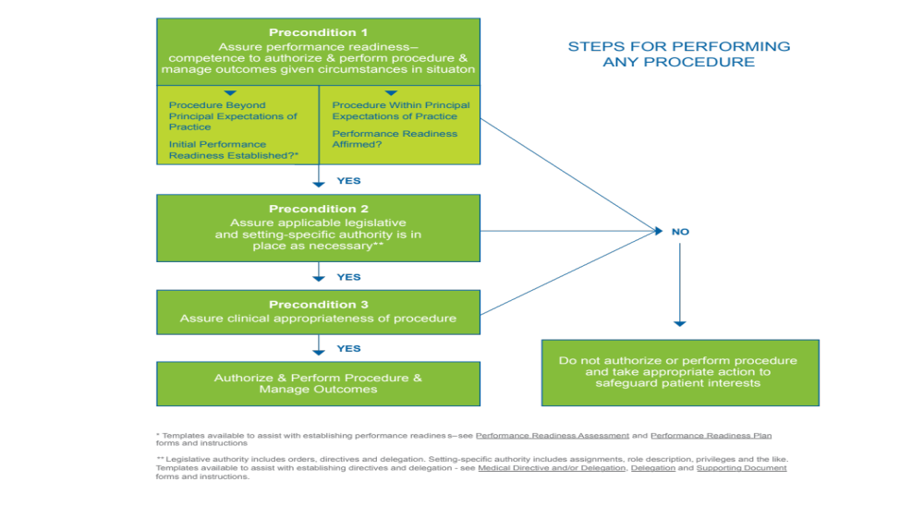

Slide 40
Readiness Assessment For Being a Delegatee
Does the delegation directly address a patient’s needs
  Directives, delegation or practices beyond principal expectations may only be established to address patient interests and are only acceptable when the resulting care is always the same or better that it would be without the directive
Examples include – care closer to home or in a more logistically acceptable way

Slide 41
Readiness Assessment For Being a Delegatee cont’d
Can the Authorizer delegate the action:
  Do they have the scope, authority from their college, competencies and privileges (where applicable) to authorize performance
  Do they have an established or anticipated professional relationship with the patient?
  Do they agree the directive applies to all his or her patients who meet the conditions? (in case of directives)
  Do they have the ability to provide ongoing supervision directly, or are other provisions for appropriate supervision in place?

Slide 42
Readiness Assessment For Being a Delegatee cont’d
Do you the implementer:
  Have the scope and authority from their own college (where applicable) to perform the procedure(s)
  Have the baseline competencies to perform the proposed procedure(s) and manage the outcomes given the:
    predictability of the patient’s condition and needs,
    predictability of the procedure and its outcomes, and
    circumstances in the situation including resources and safeguards (such as established standards of practice, written materials, back-up and supervision), and opportunities to attain and maintain competence?

Slide 43
Readiness Assessment For Being a Delegatee cont’d
Can informed consent be properly obtained?
Quality Assurance
  Is there a process in place to ensure a regular review of the directive or delegation?
  Is there a process in place to address questions or concerns arising from the directive or delegation?
Practice Setting
  Are the necessary human and material resources available to support the practice?

Slide 44
Readiness Assessment For Being a Delegatee cont’d
Do the benefits of proceeding by way of the directive, delegation or practice outweigh the risks?
Educational
  Is there a plan for enabling implementers to attain the necessary competencies and achieve performance readiness?
  Is there a plan for informing stakeholders and for activating the directive, delegation or practice?
  Are there references to support practice?

Slide 45
Important Notes For Delegation Vascular Access & Compounding
Document Training
  Delegatee should sign off on SOPs and Training program
  (we will be looking at offering a training course for delegatees for IVIT)
Document Supervised Procedures
  Formulate the number of supervised procedures you should observe prior to independent practice
Document Ongoing QA
  Formulate a schedule for checking competent delivery of service in the workplace (every 6-12 months)

Slide 46
Clinical Care Resources
Templates of functional assessments
Delegation guidance documents taken from Federation of Health Regulatory Colleges of Ontario
Performance Readiness
  Performance Readiness Assessment Template and Instructions
  Performance Readiness Plan Template and Instructions
Medical Directive
  Medical Directive or Delegation Template and Instructions

Slide 47
Conclusion
Ensure you have instituted consistent thorough assessment of every patient including H&P, Functional Assessment, Laboratory Assessment, Imaging, etc.
Ensure you provide consistent follow up assessing safety and tolerability of IVIT treatment appropriate to the patient’s condition
Ensure when providing or accepting delegation establish patient need, provider/institutional readiness and ensure ongoing follow up

Slide 48

Thank You

